Slide 1
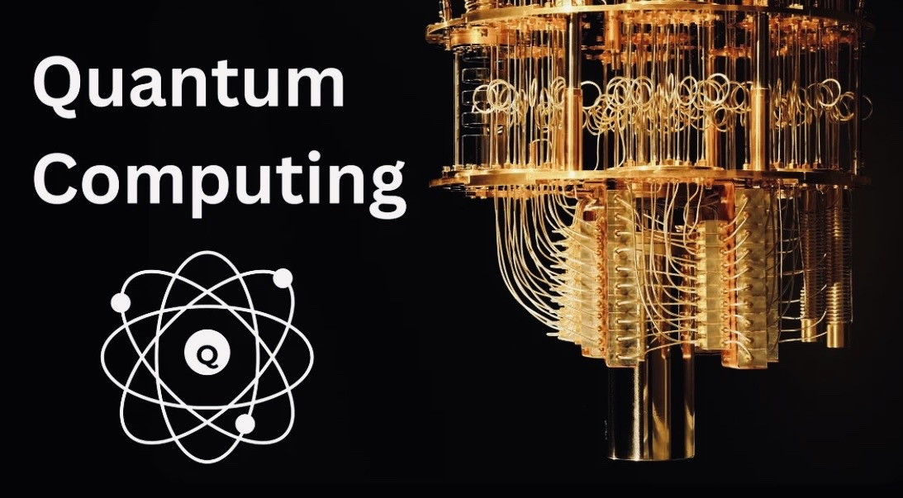
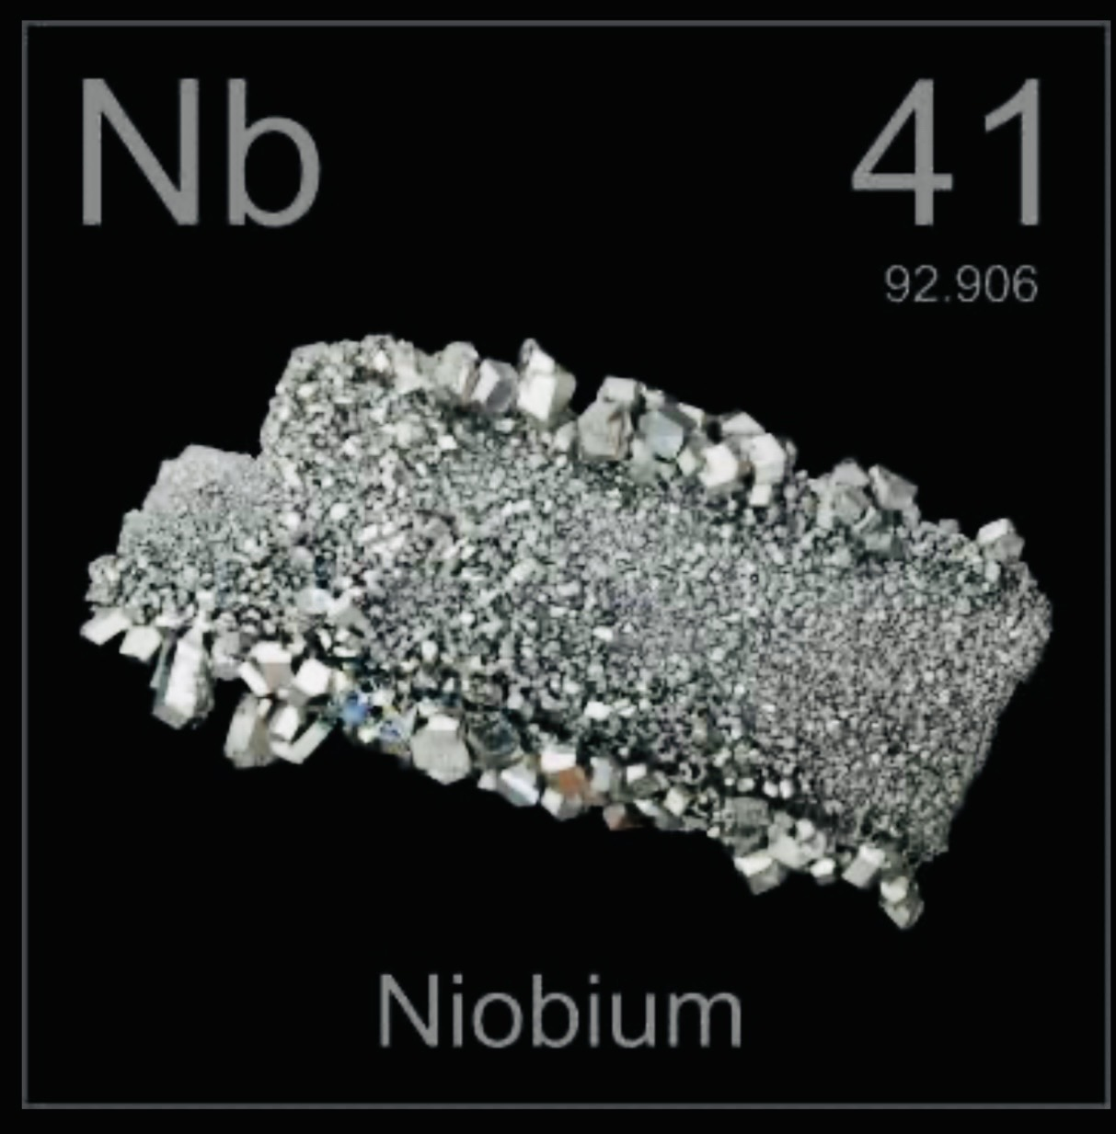
ALCM Critical Minerals
Niobium-Focused
Critical Minerals &
Quantum Computing Unit
ALCM Critical Minerals | Confidential

Slide 2
Investment Thesis
Critical metal.
Concentrated supply.
Industrial necessity.
Quantum optionality.
ALCM Critical Minerals | Confidential

Slide 3
Why Niobium
Steel.
Aerospace.
Pipelines.
Energy infrastructure.
Strategic access > simple commodity.
ALCM Critical Minerals | Confidential

Slide 4
Quantum Relevance
Superconducting
quantum systems
create real
strategic optionality.
ALCM Critical Minerals | Confidential

Slide 5
Business Model
Phase | Model | Economics
1 | Mandate / broker / advisory | 1%–5% fees
2 | Back-to-back physical | Merchant spread
3 | Strategic supply solutions | Premium contracts
ALCM Critical Minerals | Confidential

Slide 6
ALCM Edge
Risk intelligence.
Macro credibility.
Institutional access.
Security-of-supply narrative.
ALCM Critical Minerals | Confidential

Slide 7
Strategic Positioning
We do not sell metal.
We sell strategic access.
ALCM Critical Minerals | Confidential

Slide 8
Closing
Right asset.
Right narrative.
Right time.
ALCM Critical Minerals | Confidential

