Slide 1
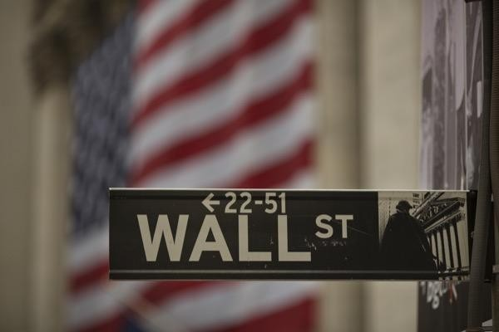


Slide 2
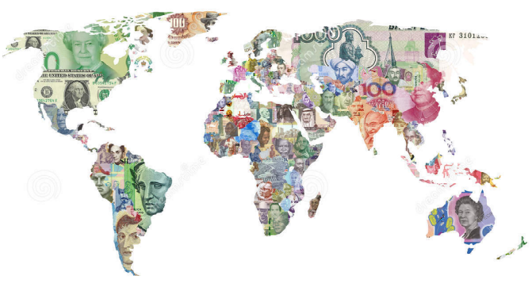
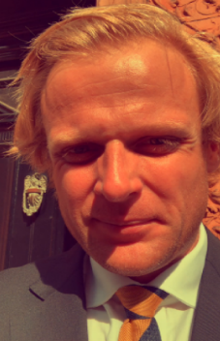

executive summary
Firm: AL Capital Management is a specialist financial services boutique focused on risk management advisory for leading investment banks, commodity trading houses, corporations, hedge funds, private equity firms, sovereign wealth funds, governments and UHNW clients.
Focus: The firm’s core expertise lies in oil & metals (physical and derivatives) trading, foreign exchange and global macro risk, combining deep market structure knowledge with advanced technical & financial analysis, fundamentally quantitative approach.
History: Founded in London in 2012, firm currently does not manage external capital. Revenue is generated through bespoke, high-quality advisory services delivered to a carefully selected client base. While advisory remains the firm’s primary focus, managing external capital is not excluded as a future opportunity.
Clients: The firm has advised a broad range of institutions, including Bank of America Merrill Lynch, Credit Suisse (now UBS), Standard & Poor’s, the National Bank of Kuwait, among others.
Management: The firm is led by Agris Lauzinieks (CRA), who brings 20 years of experience in risk management and global economic research, gained across New York, London and Zurich. His background combines expert-level technical & financial analysis, and macroeconomic insight, with a strong focus on capital preservation and asymmetric risk management.
Philosophy: business operates with a competitive and aligned fee structure, ensuring clients benefit from world-class risk management expertise while keeping incentives firmly aligned. The client’s success always comes first.

Slide 3
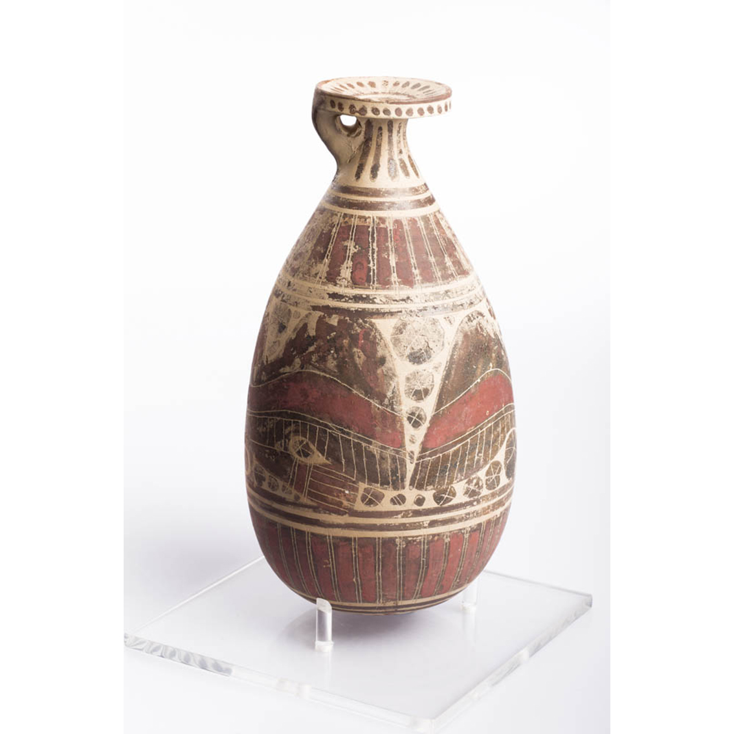
technique
Psychoanalysis & Mindset
A disciplined, mechanical trading framework is always applied, maintaining a calm, objective, and emotionally neutral decision-making process. All forms of subjective bias and wish-based decision-making are systematically eliminated applying AI driven algorithms.
Money Management
A strict risk culture governs all activity, with maximum loss per position capped <2% of equity. Trades are structured with a preferred risk-to-reward ratio of 1:3 and trading activity is suspended after 3 consecutive losses, ensuring capital preservation remains paramount.
Trading Tactics
Entry timing is determined through AI-assisted quantitative models, validated by price action, momentum and mean-reversion analytics. Execution remains rule-based and data-driven.
Unique Edge
An institutional, military-grade risk management framework underpins all strategies. Research is driven by physics & mathematics-based methodologies, combined with systematic psychoanalysis of market particles to reduce entropy and control downside risk.

Slide 4
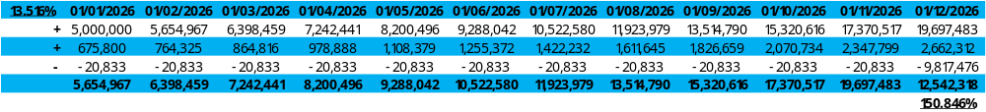

mathematics
AuM sought: $5m
Target ROI: >150%
Management fee: 5%
Performance fee: 44%
Maximum drawdown: 5% ($250k)

