Slide 1

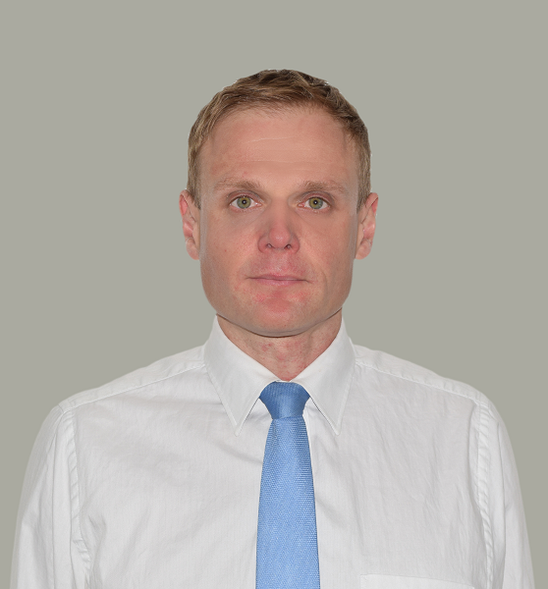






















































Agris Lauzinieks
AL Capital Management
agris.lauzinieks@gmail.com / agrisf1.blog / +44.753.2250.224
29-5 Courtfield Gardens, London, United Kingdom, SW5 0PH
Skills: Risk Management, Energy Trading and M&A Advisory
Founded: 13/02/2012 (13)
UBO: Agris Lauzinieks (100%) born in Rēzekne, USSR on 24/05/1980 (45)
Citizenships: United Kingdom; Latvia (EU); Switzerland (B)
Track record:
20-years international investment banking experience in New York, London, Zurich, Monaco, Riga, Moscow and Dubai helping clients to trade in financial markets, ship energy commodities around the world, structure and raise money for mergers & acquisitions.
Strong expertise in the oil & gas, renewables, metals & mining, defense & aerospace, automotive, construction, real estate (commercial & residential), sports, financials (banks, hedge funds & private equity and family offices).
Expert in technical & fundamental analysis, psychoanalysis, business development, cash flow and portfolio stress testing of risk assets. Developed own unique liquidity assessment methodology for corporate clients and financial institutions, governments.
VIP grade international UHNW network with actionable trade opportunities.
2010-2025: Bayes Business School Seminars & Conferences
2010-2025: London School of Economics & Political Science Public Lectures
2011: NYU Stern School of Business (Kaufmann Management Centre) Executive Diploma in Capital Markets
1998-2004: RTU Faculty of Engineering Economics & International Business Bachelor’s & Masters Degrees in Business Management / Entrepreneurship & Economics
Clients:
Interests: Krav Maga & Alpine Skiing, Basketball and Scientific Research
Languages: Latgalian, Latvian, Russian, English, German & French
IT: MS Office, ChatGPT, Bloomberg, CapitalIQ, Basic, Pascal & Phyton

